Slide 1
Knowledge Nugget #5: Fund Development – The Basics

Slide 2
Fund Development – The Basics
Documenting Charitable Gifts
Different Types of Gifts
Gift Acceptance Policies
Material Restrictions

Slide 3
My Contact Information
David Bennett
Cell: 260-804-5617
Email: cfrtinstitute@gmail.com
Website: www.cfrti.com

Slide 4
Different Types of Gifts

Slide 5
Types of Gifts
Community Foundations are uniquely positioned to receive many types of gifts. While most gifts are in the form of immediate payments, successful foundations have the capacity to accept a wide variety of gifts.
Gifts might be immediate gifts, which are easy to value and can be used when given to fill a charitable purpose. They may be complex gifts, which are harder to value and convert to cash but which nonetheless may be very valuable.
They might be deferred gifts, which do not come to fruition until some point in the future – maybe a very long time into the future.
They might also be gifts with income, in which the donor gives assets in return for a stream of income.

Slide 6
Examples of Immediate Gifts
Cash, checks, credit card gifts
Publicly traded stock and mutual funds
Tax benefits with appreciated assets
Must be transferred directly to community foundation
IRA Charitable Rollover
Qualified Charitable Distribution

Slide 7
Examples Complex Gifts
Retained Life Estate
Bargain Sale
Business Interest
Closely-Held Stock
Tangible Personal Property
Collectibles, artwork, vehicles, equipment
Agricultural Products
Livestock, harvested crops, cut timber

Slide 8
Examples of Deferred Gifts
Charitable bequest - a transfer at death by will to a 501(c)(3) organization
Most common form of estate gift
Have sample language available on website and in marketing materials
Retirement Funds
Best asset to leave to charity in estate…heirs are taxed
Can use Qualified Charitable Distributions/IRA Charitable Rollover
Life Insurance
Donor owns policy, community foundation as beneficiary, no tax deduction
Donor transfers ownership and beneficiary to community foundation, possible tax deduction
Community foundation purchases policy, donor pays premium, tax deduction for premium

Slide 9
Examples of Gifts with Income
Charitable Gift Annuities
Pays one or two people, then remaining balance to community foundation
Community foundation assets liable for payments
Charitable Remainder Trusts
Pays beneficiary first, then remaining balance to community foundation
Additional gifts can be added to Charitable Remainder Unitrust
Charitable Lead Trusts
Pays community foundation first, remaining balance to beneficiary(ies)

Slide 10
Gifts That Could Cause a Charity to Pay Tax
Even though an organization is recognized as tax exempt, it still may be liable for tax on its unrelated business income.
For most organizations, unrelated business income is
income from a trade or business,
regularly carried on,
that is not substantially related to the charitable, educational, or other purpose that is the basis of the organization's exemption.
An exempt organization that has $1,000 or more of gross income from an unrelated business must file Form 990-T.

Slide 11
Examples of Gifts that Generate UBI
Subchapter S Stock – If a donor gives Subchapter S stock to a community foundation, the donor’s tax basis transfers to the community foundation. When the stock is sold, the community foundation must file a Form 990-T, and may own taxes
Operating Businesses – If a donor gives an operating business to a charity, and the business continues to operate, the charity may need to file a Form 990-T, and may owe taxes. For example, if a community foundation is gifted a convenience store and gas station, and continues to operate the business, they must file a Form 990-T.
This is true even if the profits from the store are deposited into a charitable fund held by the community foundation.

Slide 12
Gift Acceptance Policies

Slide 13
Why Do You Need Gift Acceptance Policies?
While we usually think of a charitable gift as a donor writing a check, in many instances a charitable gift can be made using many different types of assets.
The most common type of non-cash gift is publicly traded marketable securities. But some donors may want to make a gift of real estate, grain, or artwork.
Suppose a donor wants to give a cemetery plot, a vacant warehouse, or a valuable piece of art to your community foundation. Will you accept it? Who makes that decision? What will you do with it after you receive it?
These types of questions – and much more – can be answered in your gift acceptance policy.

Slide 14
What Is a Gift Acceptance PolicY
A gift acceptance policy governs the assets you accept as gifts
Defines type of assets that are acceptable
Cash, check, publicly traded securities – no problem
Land, art work, etc.? These can be tricky
What types of planned gifts will you take?
Creates procedures for dealing with gifts, for example:
Liquidate stock immediately
Obtain an environmental study on land
Approved by the board and reviewed periodically
You do not have to accept every gift

Slide 15
Form 990 Schedule M
Keep in mind that on your Form 990 the IRS asks whether or not you have a gift acceptance policy. It will also ask you questions about that policy, and also to disclose information about noncash gifts you have received.

Slide 16
Key Elements in a Gift Acceptance Policy
1. Who has the authority to negotiate the details of the gift?
2. What types of gifts will, and won’t, be accepted?
3. What gifts will require a written gift agreement, and what will be in that agreement?
4. Who will bear the carrying cost of assets that cannot be liquidated immediately?

Slide 17
Key Elements in a Gift Acceptance Policy
5. Who will bear the cost of substantiating the value of a gift the donor will claim on his or her income tax return?
6. When will your organization agree to retain a gift versus liquidating a gift as soon as is practicable?
7. Will you offer charitable gift annuities, and what is your policy regarding valuing those annuities?
8. Will you accept a gift that could generate unrelated business income?

Slide 18
Making Sure your Policy is Effective
Monitor the policy. The board should review the gift acceptance policy on an annual basis and will need to approve any changes to the policy.
Make the policy widely available. Put the policy on your website, so that you can direct donors to the policy when a question arises.
Educate your staff. While the details of the policy are most important to your executive director and development staff, all of your staff should be familiar with the policy.
Educate new board members. As part of their orientation, new board members should receive a copy of the organization’s gift acceptance policy. Take time periodically to review the highlights of the policy at a board meeting.

Slide 19
Planned Giving

Slide 20
Planned Giving
A planned gift is a contribution that is arranged in the present and allocated at a future date.
A community foundation is uniquely positioned to receive a planned gift. A community foundation is designed to last forever, so a donor can leave a gift that might not occur until many years in the future. In addition, a community foundation usually has a finance and accounting system in place that will allow for the acceptance of complex gifts.

Slide 21
What Type of Donor Leaves a Planned Gift?
The following pages show data on donors who leave a planned gift.
Most planned gifts are developed and put into place many years – perhaps many decades – before the gift is actually made to the charity.
The following slides also emphasize the importance of a donor’s professional advisor in preparing a planned gift. In almost every instance, a planned gift will be crafted with the help of a donor’s trusted advisor – an attorney, a CPA, or a financial advisor. Sometimes, multiple professional advisors will be involved.
That’s why it’s important for a community foundation to maintain strong ties with your professional advisor community. At best, you want a professional advisor to be your advocate. At the very least, however, you want a professional advisor to know what a community foundation is and what it does. While a professional advisor many not be an advocate for your foundation, at the very least they serve as a gatekeeper, and must give their approval for any planned gift.

Slide 22
Percentage of Households with Will, By Age

Slide 23
Estates with a Charitable Gifts, by Wealth

Slide 24
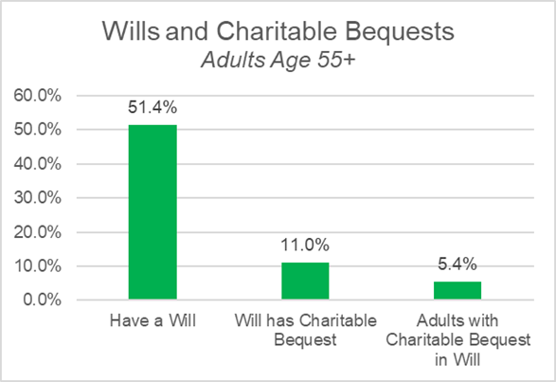
Adults with Wills and Bequests

Slide 25
Wills with Charitable Bequest by Education

Slide 26
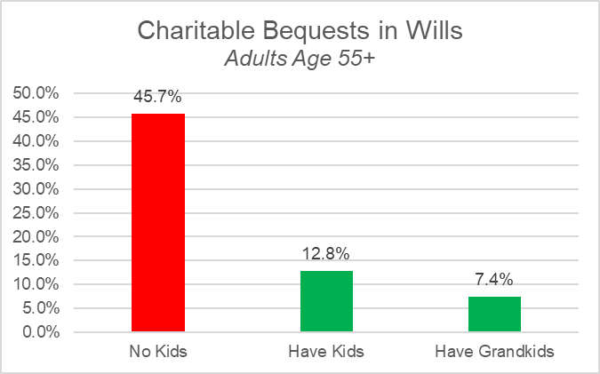
Who Leaves a Charitable Bequest?

Slide 27
Material Restrictions

Slide 28
What is a Material Restriction?
A material restriction is a restriction or condition that prevents a community foundation from "freely and effectively employing the transferred assets, or the income derived therefrom, in furtherance of its exempt purposes.”
A gift dependent on the performance or an occurrence of an event is not a completed gift until that event occurs
A gift must be irrevocable to qualify as charitable deduction

Slide 29
Requests That Are Not Material Restrictions
A name that memorializes the donor
On a fund, or a building
Requests for anonymity
Designation by the donor of a charitable purpose or a public charity as the beneficiary of the fund.
Creation of the fund as an endowment.
A requirement that the community foundation retain the property, if such retention is important to the achievement of charitable or other similar purposes in the community because of the peculiar features of the property.

Slide 30
Examples of Material Restrictions
The donor’s retention of a right to direct distributions to particular charitable beneficiaries.
The donor’s retention of a right to direct the timing of charitable distributions.
The donor’s right to select and keep an investment manager of their choosing
But … none of these are material restrictions if the board of the community foundation has ultimate authority to make the final decision!

Slide 31
Documenting Charitable Gifts

Slide 32
When is a Gift Receipt Required?
Gift of money or other property to a qualified organization
Gift acknowledgement is required for gifts of $250 or greater

Slide 33
Requirements for a Charitable Gift Receipt
Must include these items to meet the standards set forth by the IRS:
The name of the organization;
The amount of cash contribution;
A description (but not the value) of non-cash contribution;
A statement that no goods or services* were provided by the organization in return for the contribution, if that was the case;
Statement that the community foundation has exclusive control of the gift
*Or, A description and good faith estimate of the value of goods or services, if any, that an organization provided in return for the contribution;

Slide 34
Additional Documentation Required
The CARES Act now allows donors to deduct from income up to $300 ($600 for a married couple filing a joint return) for those taxpayers who do not itemized deductions on their tax return.
The new law specifies that the deduction is NOT available for a gift to a donor advised fund.
Therefore, you tax documentation should have a paragraph stating whether or not the gift was made to a donor advised fund.

Slide 35
Other Requirements for a Charitable Gift Receipt
Each donor receipt should include the name of the donor. Many donor receipts also include the charity’s address and EIN, although not required.
Donor receipts should include the date of the contribution. If the donor receipt doesn’t include the date, the contribution may be disallowed entirely.
Donor must reduce the amount of the contribution deduction by the fair market value of the goods and services provided by the organization.

Slide 36
Documentation of Noncash Gifts
In some instances, the community foundation may need to provide additional documents for certain noncash gifts.
This documentation might include the filing of Form 8283 or Form 8282. These are explained in more detail on the next couple of slides.
Schedule M of the Form 990 will also ask you additional information about noncash gifts you have received.

Slide 37
IRS Tax Forms - 8283
Filed with donor’s tax return for all noncash gifts > $500, includes partnerships and S corporations
Corporations must file for gifts > $5,000
Donor’s responsibility to complete and file
Qualified Appraisal required for most non-cash gifts
Qualified Appraisal summary must be signed by the CF

Slide 38
IRS Tax Forms - 8282
Required with sale of donated property
Any property other than cash or publicly traded securities reported with a charitable value that exceeds $5,000
Filled out by the community foundation for property disposed of within three years of receipt/contribution by donor
Must be filed within 125 days after the disposal

Slide 39
My Contact Information
That’s it for this Knowledge Nugget. If you want to test what you learned, there’s a short quiz located elsewhere on this website.
If you have any questions or comments, please contact me using this information
David Bennett
Cell: 260-804-5617
Email: cfrtinstitute@gmail.com
Website: www.cfrti.com
Keep up the good work … what you are doing for your community is so important.

