Slide 1
Knowledge Nugget # 7 Lobbying by community foundations
What are the rules?

Slide 2
Community foundation research and training institute
David Bennett
Cell: 260-804-5617
Email: cfrtinstitute@gmail.com
Website: www.cfrti.com

Slide 3
Lobbying by community foundations
As community foundations explore their community leadership role, they may want to undertake activities that try to influence public policy, commonly known as “lobbying”
All 501-c-3 organizations – including community foundations -- face certain rules and regulations when they venture into lobbying activities
This presentation is designed to provide some background on laws governing lobbying by community foundations
Before engaging in lobbying activities, community foundations are strongly encouraged to check with your legal counsel regarding rules in your state

Slide 4
Background
Federal tax laws already allow every charitable nonprofit to engage in some legislative lobbying activities.
The Internal Revenue Code, in 1934, determined that, for charities, “no substantial part of the activities” may be for “carrying on propaganda, or otherwise attempting, to influence legislation.”
All charitable nonprofits – including community foundations -- may freely engage in legislative lobbying as long as that activity amounts to only an “insubstantial” amount of their activities.
Note: There is no limitation on “self-defense lobbying”, i.e., lobbying on legislation that directly effects a community foundation

Slide 5
Political campaign activities vs lobbying
It’s important to note that the law makes a clear and important distinction between political campaign activities and lobbying
Form 990 defines political campaign activities as “All activities that support or oppose candidates for elective federal, state, or local public office. “
A community foundation cannot, under any circumstances, engage in political campaign activities

Slide 6
Community foundation involvement in political campaigns
Political campaign activity does not include any activity to encourage participation in the electoral process, such as voter registration or voter education, provided that the activity does not directly or indirectly support or oppose any candidate
Engaging in unlawful political campaign activities could result in revocation of nonprofit status, monetary penalties, or both
Community foundation staff or board members who wish to personally engage in political campaign activities should make sure their personal involvement does not include any connection to the community foundation (such as use of their community foundation email address, or a link to the community foundation’s website)

Slide 7
What is “lobbying”?
The IRS defines “lobbying” as “All activities intended to influence foreign, national, state, or local legislation”
Lobbying can be either “direct” or “grassroots”
Direct lobbying - costs incurred for the purposes of attempting to influence legislation through communication with any member or employee of a legislative body or with a government official or employee that may participate in the formulation of the legislation.
Grassroots lobbying - any attempt to influence legislation through an attempt to affect the opinions of the general public or any part of the general public
Generally, either grassroots or direct lobbying communications needs to refer to a specific piece of legislation and reflect a view on the legislation before it the activity will be considered “lobbying”

Slide 8
So … what is “insubstantial” lobbying?
The definition of “insubstantial” has not been provided by Congress or the IRS
Community foundations can lobby, and then provide evidence that their lobbying is an “insubstantial” part of their activities – which the IRS is free to accept or reject using its own subjective criteria
To avoid the uncertainty of a nonprofit's lobbying activity being measured with this subjective test, community foundations can file Form 5768 “Election/Revocation of Election by an Eligible Section 501(c)(3) Organization to Make Expenditures to Influence Legislation”

Slide 9
why file form 5768?
Filing Form 5768 is also known as "taking the 501(h) election"
The 501(h) election allows the community foundation to opt out of the vague "substantial" activity test and use the friendlier “expenditure” test.

Slide 10
The Expenditure test With 501(h) election
The 501(h) election provides for a fixed dollar limit to the “lobbying nontaxable amount” that is based on the community foundation’s exempt purpose expenditures.
Form 5768 can be filed and applied retroactively to the first day of the year in which it was filed.
The 501(h) election is then in effect for all subsequent years unless revoked by filing a second version of the 5768.

Slide 11
Direct Lobbying limits under the 501(H) election
Total Exempt Purpose Expenditures | Related Direct Lobbying Nontaxable Amount
Not over $500,000 | 20% of total exempt purpose expenditures
Over $500,000 but not over $1,000,000 | $100,000 + 15% of the excess over $500,000
Over $1,000,0000 but not over $1,500,000 | $175,000 + 10% of the excess over $1,000,000
Over $1,500,000 but not over $17,000,000 | $225,000 + 5% of the excess over $1,500,000
Over $17,000,000 | $1,000,000
The nontaxable amount for grassroots lobbying expenditures is 25% of these amounts

Slide 12
What if your lobbying exceeds the expenditure limits?
If a community foundation exceeds the nontaxable amount of lobbying expenditures, they will need to pay excise tax by filing Form 4720 Return of Certain Excise Taxes Under Chapters 41 and 42 of the Internal Revenue Code
The excise tax will be 25% of the amount of expenditures over the nontaxable amount.
Furthermore, if the community foundations’s lobbying expenditures on average exceed 150% of the nontaxable direct lobbying or grassroots lobbying amount over a four-year period, the community foundation will lose its exempt status.

Slide 13
Form 990 disclosure
An organization that answered "Yes" on Form 990, Part IV, Checklist of Required Schedules, line 4 must complete the appropriate parts of Schedule C and attach Schedule C to Form 990.
“Did the organization engage in lobbying activities, or have a section 501(h) election in effect during the tax year?”

Slide 14
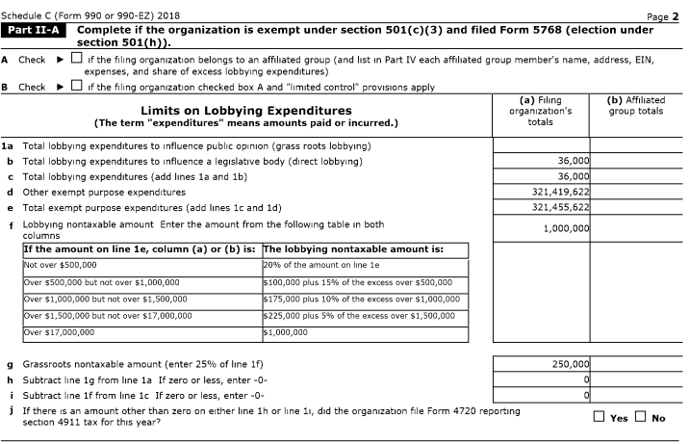
Example, form 990, Schedule C, Part II-A
Filed Form 5768
Foundation for the Carolinas

Slide 15
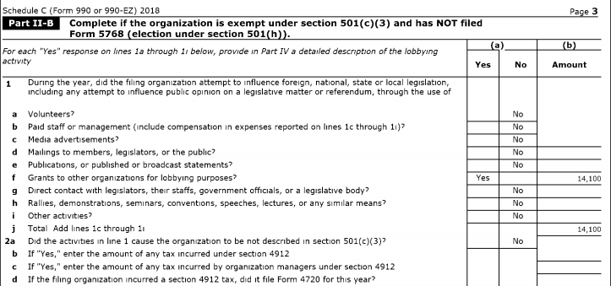
Example, form 990, Schedule C, Part II-B
Has Not Filed Form 5768
Central Indiana Community Foundation

Slide 16
Summary
Community foundations are subject to the same rules as all 501-c-3 organizations when it comes to lobbying activities
Lobbying is permitted, but must be an insubstantial part of your activities
Community foundations can clarify the extent of their lobbying by filing Form 5768 and "taking the 501(h) election"
Community foundations are strongly encouraged to consult with their legal counsel and their auditors if they have questions about this process

Slide 17
Community foundation research and training institute
David Bennett
Cell: 260-804-5617
Email: cfrtinstitute@gmail.com
Website: www.cfrti.com

