Slide 1
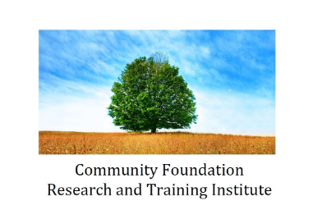
Knowledge Nugget #1:
Community Foundation Structure and History

Slide 2
Community Foundation Structure and History - Contents
History And Community Foundation Models
National Standards
National And State Organizations
Affinity Groups

Slide 3
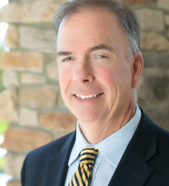
My Contact Information
David Bennett
  Cell: 260-804-5617
  Email: cfrtinstitute@gmail.com
  Website: www.cfrti.com

Slide 4
Birth of Community Foundations
The first community foundation was created in Cleveland in 1914. While local economies change over time, in 1914 Cleveland was a center of business and wealth creation – steel, shipping and banking, to name just a few industries that were important.
It is generally recognized that Frederick Goff, a businessman from Cleveland, was the founder of the first community foundation – The Cleveland Foundation

Slide 5
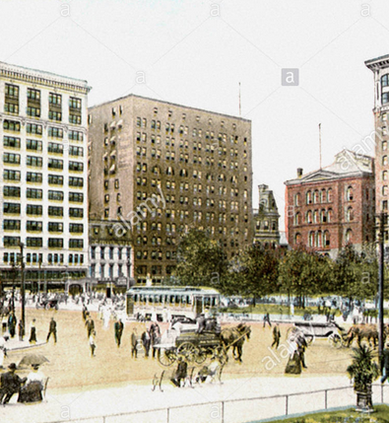
Cleveland Foundation
First Community Foundation - Created in 1914

Slide 6
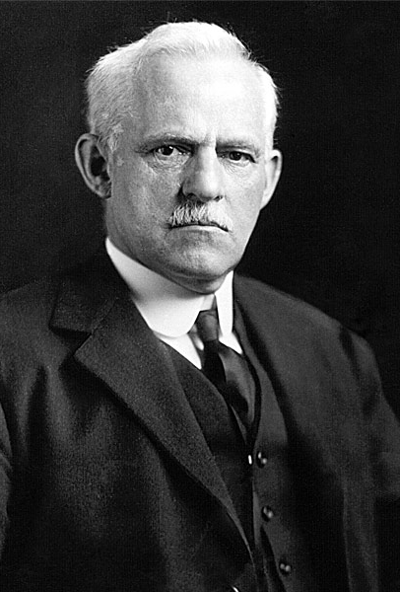
Frederick Goff
Determined to find a better method for passing money from one generation to the next
Encouraged individuals to “pool” their money to meet the ever-changing needs of the community.
In 1914, he created The Cleveland Foundation.
The income generated by their investment would be allocated back into the community by an advisory team of local community leaders.

Slide 7
How Is A Community Foundation Created?
A community foundation is created by a group of community leaders who come together and collectively decide to start the foundation.
Community foundations come in two types – trusts and corporations. In the early years of the field, almost all community foundations were in trust form – that is, a trust was created which was governed by trustees.
In later years – and particularly for the last 30 years – nearly all community foundations that were created were in corporate form, and are governed by a board of directors.

Slide 8
The Community Foundation Field in 1931
The next slide shows a document created in 1931 which was a census of all of the community foundations which existed in that year. The document lists 72 community foundations across the country – only 40 of which actually had assets in 1931.

Slide 9
Community Trusts in 1931
72 Community Foundations
40 of which had funds
This document is available for download elsewhere on our website.
Notes:
A survey of community foundations was completed in 1931. There where about 150 community foundations in America at one time, including the Fort Wayne Foundation.

Slide 10
Growth in Last 30 Years
As the next slide shows, more than half of all community foundations were created in the 1980s and 1990s.
Today, almost all community foundations are in corporate form, but some of the older community foundations are still in trust form. Some foundations even operate under both trust form (for their older funds) and corporate form (for their newer funds)

Slide 11
Founding Year
All Community Foundations

Slide 12
Who Governs a Community Foundation?
A community foundation is governed by trustees (if in trust form) or board members (if in corporate form).
If in trust form, a trustee is often appointed by a local bank.
In most instances with corporate form, board members are chosen by existing board members. In some instances, however, a board member might be appointed by a local institution – the local courts, for example, or the city or county where the community foundation is located.

Slide 13
How is a Community Foundation defined?
There is no legal protection for the phrase “community foundation”. Anyone can create a corporation and give it the name “community foundation”.
To try to more clearly define just what a community foundation is, about 20 years ago leaders in the field came together to create a definition of a community foundation. This definition is on the next slide.

Slide 14
Definition of a Community Foundation
Nonprofit, tax exempt under section 501(c)3
Independent, non-sectarian governing body
Publicly supported by many unrelated donors
Goal of building permanent component funds
Benefits the residents of a defined geographic area
Supports broad-based charitable interests
Serves in leadership role on community issues

Slide 15
So .. How many community foundations are there?
Because of the rapid growth of the field in the last 30 years, it’s likely true that just about every populated area of the United States is served by a community foundation.
In most instances, one community foundation is created to serve a particular geographic area. There are exceptions to this, however, as there are examples of a single area served by two or more foundations. Generally, however, it is more efficient to have a single community foundation serve a particular area

Slide 16
So … How Many Community Foundations are there?
We think
Around 866

Slide 17
So .. How many community foundations are there?
So, we think there are about 866 community foundations operating in the United States.
The next slides show a breakdown by asset levels. More than half of all community foundations have assets under $20 million. On the other end of the scale, at least 60 community foundations have assets in excess of $300 million.

Slide 18
Number of Foundations, By Size

Slide 19
Assets Held by Community Foundations
These 866 community foundations operating in the United States have total assets of about $90 billion.
The largest community foundations hold most of those assets. Community foundations with assets above $300 million hold about two-thirds of all community foundation assets in the United States.

Slide 20
Assets of Foundations, By Size

Slide 21
Assets Held by Community Foundations
The next slide shows the largest community foundations in the United States, based on assets in 2017.

Slide 22
Largest Community Foundations
Name | Year Founded | Assets 2017
Silicon Valley Community Foundation | 2006 | $ 13,574,876,130
Tulsa Community Foundation | 1999 | $ 4,437,335,394
Greater Kansas City Community Foundation | 1978 | $ 3,148,672,721
New York Community Trust | 1959 | $ 2,806,082,837
Chicago Community Trust | 1915 | $ 2,828,248,897
Cleveland Foundation | 1914 | $ 2,451,438,785
Foundation for the Carolinas | 1962 | $ 2,483,470,250
Oregon Community Foundation | 1973 | $ 2,216,373,546
Columbus Foundation | 1937 | $ 2,266,199,489
Marin Community Foundation | 1986 | $ 1,774,093,000

Slide 23
Growth Of Community Foundations
Asset growth at community foundations has been relatively modest in recent years.
As the next slide shows, for the field as a whole growth was in the low single digits from 2014 to 2015 and from 2015 to 2016.

Slide 24
Assets of Community Foundations

Slide 25
Growth Of Community Foundations
As the next slide shows, community foundation growth rates can vary significantly.
From 2014 to 2016, the fastest-growing 20% of community foundations grew at an average rate of 17.5%.
On the other end of the scale, the 20% of community foundations that grew at the slowest pace actually saw their asset levels decline by an average of -3.0%.

Slide 26
Growth of CF Assets
2014-2016 (854 Community Foundations)

Slide 27
Community Foundation Magic
While community foundations are continually receiving new gifts and creating new funds, in some communities extraortinary gifts have been given which change the community foundations – and the communities they serve – forever.
The following slides show just a few examples.

Slide 28
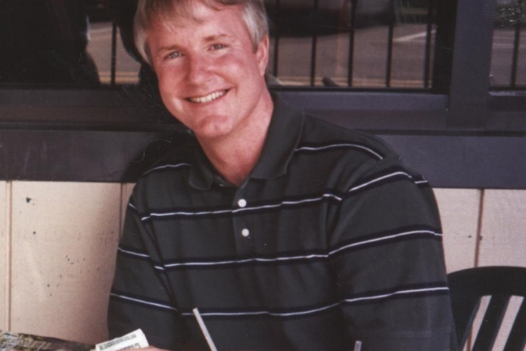
Community Foundation Magic
David Grundlach
David passed away at an early age, and left an unrestricted $175 million gift to Elkhart County Community Foundation

Slide 29

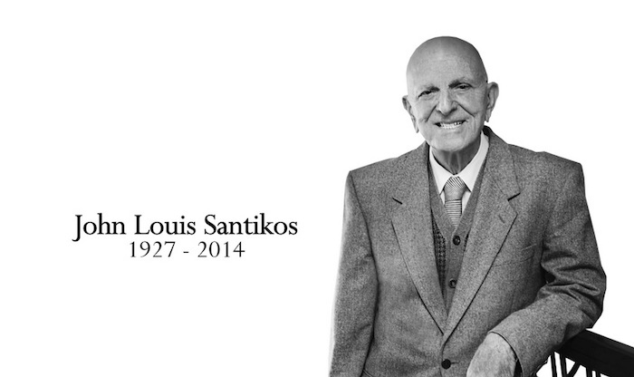
Community Foundation Magic
Mr. Santikos Left $600 Million to San Antonio Area Foundation

Slide 30
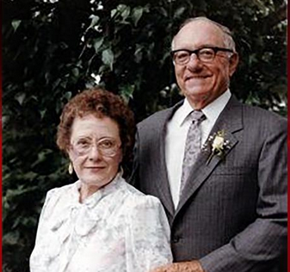
Community Foundation Magic
Mr. and Mrs. Nelson left a gift in excess of $100 million to the Fox Valley Community Foundation in Appleton, Wisconsin.
David and Rita Nelson

Slide 31
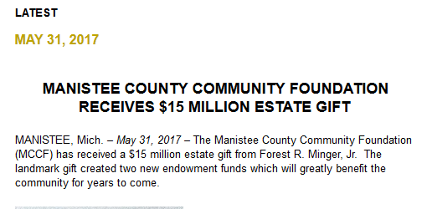
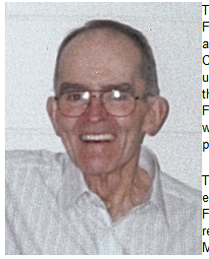
Minger Gift – Manistee, Michigan
Chemist at Dow Chemical
No family – never married
CF grew from $3 million to $25 million in just 2 years

Slide 32
Community Foundation Standards
Raising the Bar on Quality and Integrity
As the community foundation field grew, leaders in the field came together to develop standards of quality and integrity – a type of “Good Housekeeping Seal of Approval” for community foundations.
Community foundations who wish to be in compliance with the standards submit documentation of their compliance. Impartial reviewers look at the documentation and, if approved, a community foundation can publicize their achievement.

Slide 33
The Major Areas of National Standards include:
  Mission, Structure and Governance
  Resource Development
  Stewardship and Accountability
  Grantmaking and Community Leadership
  Donor Relations
  Communications

Slide 34
National Standards for Community Foundations
The national standards are administered by the National Standards Board, which is a supporting organization of the Council on Foundations
Participation is voluntary; those foundations who choose to participate pay an annual fee to cover the costs of program administration
As shown on the next page, around two-thirds of community foundations choose to participate

Slide 35
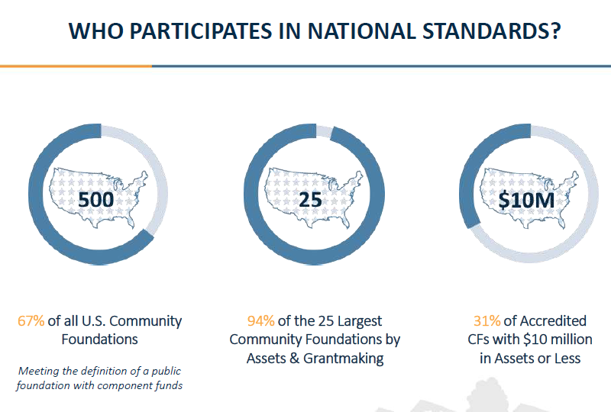

Slide 36
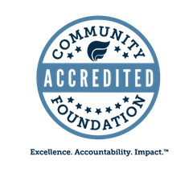
If a community foundation is found to be in compliance with the standards, they can use the following symbol in their marketing material:

Slide 37
Associations and Affinity Groups

Slide 38
National and State Associations
Community foundations can choose to be part of national and statewide associations.
At the national level, the largest organization representing foundations is the Council on Foundations. The Council provides training, legal advice, and networking opportunities to community foundations as well as other types of foundations.
Community foundations may also have access to a statewide association which also provide training, conferences and other opportunities for community foundations.

Slide 39




Affinity Groups
Staff at a Community Foundation also have the opportunity for education, training and networking through “affinity groups”, which bring together staff with similar job functions.

Slide 40
My Contact Information
That’s it for Knowledge Nugget #1. If you want to test what you learned, there’s a short quiz located elsewhere on this website.
If you have any questions or comments, please contact me using this information
David Bennett
  Cell: 260-804-5617
  Email: cfrtinstitute@gmail.com
  Website: www.cfrti.com
  Keep up the good work … what you are doing for your community is so important.

