Slide 1
Knowledge Nugget #2: Community Foundation Operations – The Basics

Slide 2
Community Foundation Operations – The Basics
Endowed And Nonpermanent Funds
Fund Types
Supporting Organizations
Community Foundation Affiliates
Community Foundation Operations

Slide 3
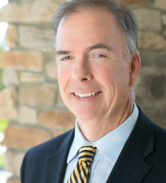
My Contact Information
David Bennett
Cell: 260-804-5617
Email: cfrtinstitute@gmail.com
Website: www.cfrti.com

Slide 4
Community Foundations in a Nutshell
A community foundation:
Receives charitable gifts from donors – Either into a newly-created charitable fund, or the gift is added to an existing fund
Invests those gifts – To generate investment returns to be used to support charitable purposes
Awards grants and scholarships – To support worthwhile charitable activities, or help a student receive an education

Slide 5
Community Foundation Core Process
Donors
Create Fund Agreements
Funds
Invested
Payout
Grants
Provide Gifts
Provide Earnings
Scholarships

Slide 6
A community foundation …
Is a 501-c-3 charitable organization, just like a school, a homeless shelter, or your local arts museum.
That means gifts to community foundations can be charitable deductions for the donor.
It also means that a community foundation’s activities must be charitable, as defined by IRS regulations.

Slide 7
Endowed vs. Nonpermanent
Community foundation funds are usually one of two types:
Endowed/Permanent fund - A fund which is invested and only a portion of the fund is available to spend annually
Pass-through/Non-Permanent Fund – Any amount in the fund can be awarded as a grant or a scholarship

Slide 8
Fund Types

Slide 9
Funds at Community Foundations
All of the assets at a community foundation are held in some type of fund. The funds are created by donors who want to make a gift for a particular charitable purpose.
Community foundations might also create a fund for their own budget – this is sometimes called their “Operating Fund”. There might also be internal funds relating to their own operations – perhaps a contingency fund (to use as backup cash) or a capital fund (to save for future capital expenditures).
In this section, however, we will only discuss funds set up by donors to achieve a specified charitable purpose.

Slide 10
Component Funds
All funds at a community foundation must be component funds.
With a component fund, the community foundation board must have total control over all assets – principal and income
The gift must be for a charitable purpose
The gift must be a completed gift with no restrictions
While the community foundation has control over component funds, each fund is accounted for individually. However, the funds can be pooled for the purposes of investing
Note: Supporting organization assets are not component funds. Supporting organizations are discuss later in this presentation

Slide 11
Types of Funds
Unrestricted Fund (or Discretionary Fund)
Field of Interest Fund
Designated Fund
Donor Advised Fund
Discretionary Scholarship Fund
Committee Advised Scholarship Fund
Advised Charitable Organization Fund
Aka Agency Endowment Fund
“Community Project Fund”

Slide 12
Unrestricted Fund
Sometimes call Discretionary Fund
Provides support for general, unspecified charitable purposes at the discretion of the community foundation
No advice or recommendation from donors (or any persons designated by the donors)
Grant decisions typically made by grants committee with ultimate approval by board
Many foundations create “named” unrestricted funds
Provide greatest flexibility now and in the future

Slide 13
Field of Interest Fund
Provides support for a general, but specified, charitable purpose (e.g., arts and culture, the environment, etc.)
No future advice or recommendations from the donors (or any persons designated by the donors)
Donor could be invited to serve on committee but only as minority vote

Slide 14
Designated Fund
Provides support for a specified public charity or charities (e.g., church, food bank)
No future advice or recommendations from the donors (or any person designated by the donors)
Fund agreement should have provision for alternative payout if charity closes

Slide 15
Charitable Organization Advised Funds Sometimes called Agency Endowments
An agency endowment is established by charitable organization
Unlike a designated fund, which is established by a donor
The charity receives an annual distribution or, if the community foundation agrees, the annual payout could be distributed more frequently
The charity can decline to take the payout, if they don’t need it and want their fund to grow
To complicate things, the accounting rules are different for an agency endowment
Amount from charity remains asset on books of charity
Amount from charity is liability on community foundation’s balance sheet
These rules do not apply to gifts to designated funds

Slide 16
Donor Advised Fund
Provides support for charitable purposes recommended by the donor or persons designated by the donor
Recommendations must be advisory only, and the community foundation must be free to reject any or all recommendations

Slide 17
Donor Advised Funds
Donor advised funds are a very popular vehicle for donors to set aside money for future charitable gifts.
A donor receives a charitable deduction for a gift made to a donor advised fund. After that point, transactions have no effect on a donor’s taxes. Any earnings are tax-free, and they cannot take a deduction for a gift made from a donor advised funds.
Because of their structure, a donor advised fund is often considered to be an attractive alternative to a private foundation. As shown on the next page, there are a number of advantages of a donor advised fund over a private foundation.
For example, there is a minimum payout from a private foundation – but not from a donor advised fund. Also, a private foundation pays a small excise tax. There are no taxes on a donor advised fund.

Slide 18
Donor Advised Fund vs Private Foundations
 | Donor Advised Fund | Private Foundation
Setup and Administration | Easy | More Complicated
AGI Limit – Cash | 60% | 30%
AGI Limit – Appreciated Assets | 30% | 20%
Excise Tax | None | 1.39%
Minimum Annual Payout | None | 5%

Slide 19
Regulation of Donor Advised Funds
Because of their growth and popularity, there have been some federal regulations which limit options for donor advised funds.
A few of these regulations are shown on the next couple of slides. A more complete explanation of donor advised fund regulations will be made in a future presentation.

Slide 20
Donor Advised Funds
A Donor Advised Fund may NOT award scholarships
A Donor Advised Fund may not grant to individuals
Fund agreement must be explicit about
next generation of advisors
disposition of fund assets when advisory period is over (i.e., keep as separate fund or add to unrestricted?)

Slide 21
Donor Advised Funds
Cannot accept a Qualified Charitable Distribution from an IRA
Cannot receive the $300 “above the line” deduction allowed in the Coronavirus Aid, Relief, and Economic Security Act (CARES Act) of 2020

Slide 22
Donor Advised Funds and Pledges
A donor can fulfill a pledge through a donor advised fund if the following apply:
The sponsoring organization makes no reference to the pledge when making the DAF distribution
Donor receives no other benefit, directly or indirectly, that is more than incidental; and
Donor does not claim a charitable contribution deduction for the DAF distribution (even if the charity erroneously sends the Donor a written acknowledgment).
IRS Notice 2017-73 (December 4, 2017)

Slide 23
Scholarship Funds
A scholarship fund is generally one of two types:
Advised Scholarship Fund
Discretionary Scholarship Fund
With an advised scholarship fund, a committee is put together to read the applications and select the recipients. As will be described in a future presentation, the donor cannot control the selection process.
With a discretionary scholarship fund, the money is awarded to an educational institution, and that school determines the scholarship recipient.

Slide 24
Scholarship Funds
All scholarships must have two elements:
Qualified charitable class
Unbiased selection process
Every member of the committee must be appointed by the community foundation (not by the donor)
Scholarship grants must be awarded according to objective and nondiscriminatory procedures, approved in advance by the board of directors
According to the Pension Protection Act of 2006, the donor and his/her designees may not control or constitute a majority of the committee

Slide 25
How Do You Determine What Type of Fund to Create?
On the next page is a chart that can be used to determine what type of fund a donor wants to create.
By answering the questions, you can trace along the path to determine the correct fund

Slide 26
What Kind of Fund Is It?
Do you Want to Support a Specific Charity?
Are you representing a charity?
Agency Endowment Fund
Designated Endowment Fund
Do you want to award scholarships?
Do you want to help choose the recipient?
Do you want the ability to recommend different grants periodically?
Advised Scholarship Fund
(Donor cannot control the process)
Discretionary Scholarship Fund
(School or other entity selects recipient)
Donor Advised Fund
Named Unrestricted Fund or Field of Interest Fund
Yes
Yes
No
Yes
Yes
No
No
Yes
No
No

Slide 27
Community Project Funds
Some community foundations allow the creation of “community project funds”. These are funds which are created for a particular local charitable project.
If your community foundation offers these types of funds, special consideration should be given to developing very clear policies and procedures. It is a good idea to have your legal council review these policies and procedures before you offer these services.

Slide 28
Community Project Funds
A group of individuals determine a solution to a community need
The group does not have 501(c)(3) status
The project can use the community foundation for donors to make charitable gifts

Slide 29
Community Project Funds
Community Foundations need a foundation policy about when you engage in these efforts
You need a written operating agreement about roles and responsibilities
You need to know the time frame and your exit plan
ACCEPTING THESE FUNDS MEANS THE PROJECT IS A COMMUNITY FOUNDATION PROJECT
Staffing issues
Liability issues

Slide 30
Supporting Organizations

Slide 31
What is a Supporting Organization?
A supporting organization is a charity that carries out its exempt purposes by supporting other exempt organizations, usually other public charities.
A community foundation can create a supporting organization by filing the proper forms with your state, and then applying for the proper exempt status.
Supporting organizations are separate corporations from a community foundation, and must file their own Form 990. It is common, however, for the financial activity of all supporting organizations to be consolidated into a single financial audit for the community foundation.

Slide 32
Large Gifts from Donors
As will be described in a future seminar, a community foundation must annually pass a financial test known as the Public Support Test. A community foundation that does not pass the Public Support Test risks being reclassified as a private foundation.
A large gift from a single donor can put a community foundation at risk of failing the public support test.
As an alternative, a community foundation can create a supporting organization (usually type I) and have the donor’s gift go to the supporting organization.
The reason? A supporting organization is not subject to the public support test.

Slide 33
Supporting Organization
Separate legal entity with its own 501(c)(3) designation from the IRS;
Does not need to meet public support test independently because it “supports” a public charity
Used for:
Large donor funds ($1 million +); more independence on grants and investments
Hold real estate; limit liability
Prevent “tipping” into private foundation status due to large grant

Slide 34
Different Types of Supporting Organizations
Type I–a supporting organization that is under direct control of the supported organization
Type II–a supporting organization that is under common control with the supported organization (also known as "brother/sister" organizations)
Type III–a supporting organization that is not necessarily related to the supported organization.
Therefore, in addition to a notification requirement, Type III supporting organizations must pass separate responsiveness and integral part tests.
This type supplies so much of the revenue for a charity that the supported charity is “responsive” and an “integral part” of the charity.

Slide 35
Disclosure on Form 990
Every supporting organization must indicate on its Form 990 which type of supporting organization it is and which organization it supports.
This disclosure provision added by Pension Protection Act of 2006

Slide 36
Affiliate Organizations

Slide 37
Affiliate Foundations
One model used to deliver community foundation services across the country is through the use of affiliates.
In this model, there is a “parent” organization, which provides back-office services such as the processing of financial transactions. Different areas in the geographic footprint of the community foundations are served by affiliates.
The affiliates are usually not separate corporations. They are overseen by advisory board members, who make decisions on local services. Legal control of affiliates remains with the board of directors of the parent organization.

Slide 38
Hybrid/Affiliate Structure
A parent organization sets up affiliate funds serving multiple communities
Those communities select how services are provided
This allows the affiliates to offer a wide range of products to suit the needs of their donors
Parent organization provides back office support
Two examples shown on the next page are the Community Foundation of the Ozarks and the Community Foundation of Greater Des Moines

Slide 39
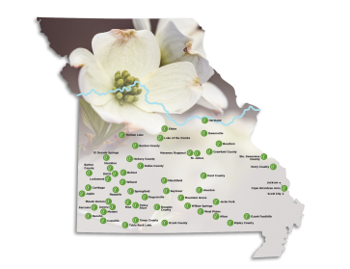
Community Foundation of the Ozarks 49 Affiliate Funds

Slide 40
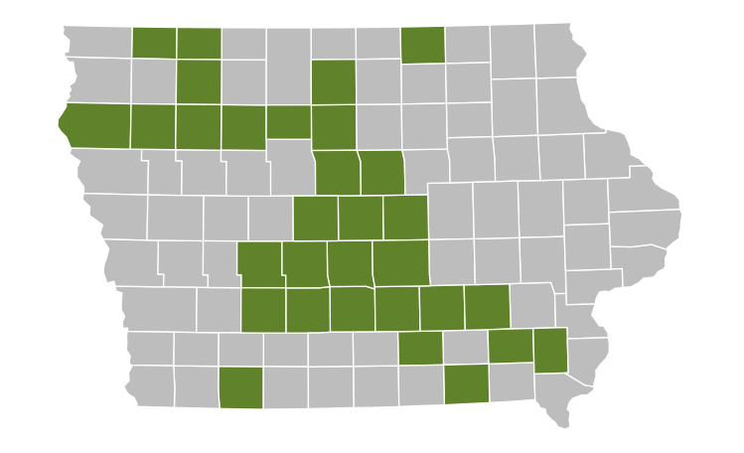
Community Foundation of Greater Des Moines 31 Affiliate Funds

Slide 41
My Contact Information
That’s it for Knowledge Nugget #2. If you want to test what you learned, there’s a short quiz located elsewhere on this website.
If you have any questions or comments, please contact me using this information
David Bennett
Cell: 260-804-5617
Email: cfrtinstitute@gmail.com
Website: www.cfrti.com
Keep up the good work … what you are doing for your community is so important.

